Slide 1

Group_1
Monthly Workforce Report – April 2026
Apr 24th, 2026
By: Shounak (Sean) Roychaudhuri

Slide 2
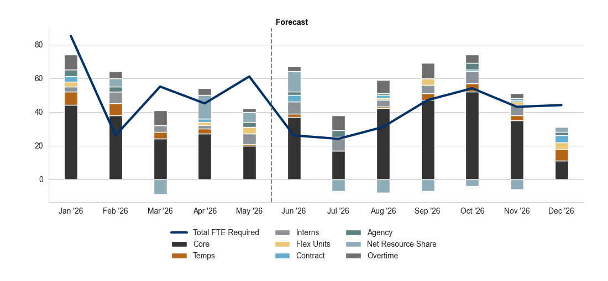
Group_1 - Staffing Levels
FY 2026 Historicals (Jan – May) + Forecast (Jun – Dec)
Highlights
Volume YoY YTD is +8% and Volume YoY Jun-Dec is forecasted to be +10%.
Average APT YoY YTD is +2% and APT YoY Jun-Dec is forecasted to be -5%.
By: Shounak (Sean) Roychaudhuri

Slide 3
Group_1 - Capacity Details
3
By: Shounak (Sean) Roychaudhuri

Slide 4
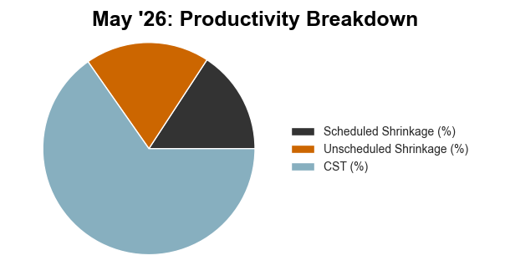
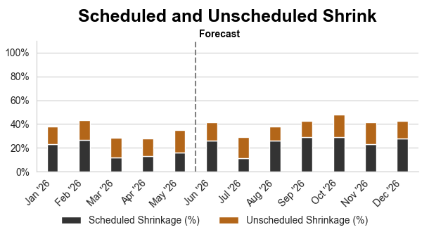
Group_1 - Shrink Details
4
By: Shounak (Sean) Roychaudhuri

Slide 5
THANKS!
Any questions?
By: Shounak (Sean) Roychaudhuri

